Slide 1
Birinci Bölüm: Information System and Business to day Organizations,Management and Networked Enterprise NE BİLMELİYİZ ?
What is new in MIS ?
Strategic Business Objectives of IS,
IS’s Örganization and Strategies
IS in Global Business,
Perspectives of IS,
What is an IS?
The role of IS in Business,
Dimentions of IS
A business perspective on IS

Slide 2
1-YBS Kısa tanımını verebilirmisiniz ?
Management Information System (MIS) is an organizational planing system for development, management, and use of Information Technology (IT) tools, to help people (workers and managers) perform all tasks and activities related to Information Processing and Management.

Slide 3
Karşımıza çıkan: Yönetim Bilişim Sistemi yapısı ?
Bilgi Teknolojisi
Information Technology
(IT)
Information System
Kavramlar
Yönetim
Management
Management Levels
İş Alanı
İş Süreçleri
Business
Business Proceses
Kurumsal
Yapı- Örgüt
Firm-Enterprise

Slide 4
Karşımıza çıkan: Yönetim Bilişim Sistemi öğeleri?
Global Business
Information System & InformationTechnology
Organization & management
Business Models
Including;
Information Processing Activities
Business Processes
Management activities

Slide 5
Teknoloji ve Yönetim Biçiminde Sürekli Değişim ? (Yansı:25)
Yönetim Bilişim Sistemlerini bilgi ve iletişim teknolojilerindeki sürekli değişim sistemi başarılı kılmak adına etkilemektedir.
Örneğin Gezgin sayısal ortamda,
“Büyük Veri” nin getirdiği değerlendirme düzeyleri,
Internet destekli Bulut Bilişim sistemlerindeki yayılma,
Iphone, Ipad, BlackBerry ve Android tabletler ile akıllı telefon sosyal medya aracı olma dışında
yönetim basamaklarında da kullanım aracı oldu..
Biliyorsunuz teknoloji her 18 ayda değişiyor, gelişiyor ?
Ayrıca yazılıma yansıyan değerlendirme yöntemleri değişiyor “Data Mining” gibi

Slide 6
Dünden Bugüne YBS de Neler Değişti ? 2014
Küresel iş alanlarımda Bilgi Sistemlerinde Güncel etkilenme:
Teknoloji (thechnology):
-Bulut Bilişim (Cloud Computing)
-Büyük veri (Big data)
-Gezgin Sayısal Ortam (Digital Mobile Platform)
Yönetim (management):
-İşbirliği ve Bilgi Paylaşımı(Collaboration &Knowladge sharing)
-İş Zekası Uygulamalarında Hızlanma(BI Application accelaration)
-Sanal toplantıda yayılma (Video & Web Conferancing)
Örgüt(Managenent):
- Sosyal iş alanı (Social net working platforms)
(facebook+twştter+blogs+wikis+on-line communication)
-İş alanlarında uzaktan iletişim (Working away from the office)
-Ortak değer ve iş değeri kazanımı (Cocreation of Business value)

Slide 7
Evrensel(global) YBS’i nasıl tanımlarsınız ?
Globalization (or globalisation) is the process of international integration arising from the interchange of world views, products, ideas and other aspects of culture.^{[1][2]} Advances in transportation and telecommunications infrastructure, including the rise of the telegraph and its posterity the Internet, are major factors in globalization, generating further interdependence of economic and cultural activities.^{[3]}
Though scholars place the origins of globalization in modern times, others trace its history long before the European age of discovery and voyages to the New World. Some even trace the origins to the third millennium BCE.^{[4][5]} In the late 19th century and early 20th century, the connectedness of the world's economies and cultures grew very quickly.
The term globalization has been increasingly used since the mid-1980s and especially since the mid-1990s.^{[6]} In 2000, the International Monetary Fund (IMF) identified four basic aspects of globalization: trade and transactions, capital and investment movements, migration and movement of people, and the dissemination of knowledge.^{[7}

Slide 8
Sayısal- Şirket (digital Fırm) Nasıl tanımlarsınız ?
The Digital Firm is a general term for organizations that have enabled core business relationships with employees, customers, suppliers, and other external partners through digital networks.
These digital networks are supported by enterprise class technology platforms that have been leveraged within an organization to support critical business functions and services.

Slide 9
İş Süreçlerini nasıl tanımlarsınız?
The unique ways in which organizations coordinate and organized work activities , information and knowladge to produce a product or sevice.
Developind a new product, creating a marketing plan hiring a empoloyee are examples of bussiness processes, and the ways organizations accomplish their business procesess can be a source of competitive strengh.

Slide 10
Sayısal- Şirket (digital Fırm) Nasıl tanımlarsınız ?
All of the changes we have just described, coupled with equally significant organizational redesign, have created the conditions for a fully digital firm.
A digital firm can be defined along several dimensions. A digital firm is one in which nearly all of the organization’s significant business relationships with customers, suppliers, and employees are digitally enabled and mediated.
Core business processes are accomplished through digital networks spanning the entire organization or linking multiple organizations.

Slide 11
Transformation of the Business Enterprise
The digital firm brings:
Electronic Commerse
Electronic Business
and New digitral relationship
Market place thar is created by computer and communication tehnologies that link many buyers and sellers transformed as Digital Market
→

Slide 12
Bilgi Sistemini kısaca Nasıl tanımlarsınız?
Information System consists of interralated components working together to collect, process, store, and disseminate information to support organizational business process, coordination, decision making, control, analysis, and visualization in an organization.

Slide 13
Bilgi Sistemini kısaca Nasıl tanımlarsınız?
Information system:
Set of interrelated components
Collect, process, store, and distribute information
Support decision making, coordination, and control
Information vs. data
Data are streams of raw facts
Information is data shaped into meaningful form

Slide 14
Bilgi Sistemi (Information Systems (IS)) fonksiyonları nelerdir?
Information System is an interrrelated components working together to collect,process, store, and diseminate information to support decision making, coordination, control, analysis and visualization in the organization.
In other words;
Information Systems (IS) is a professional and academic discipline concerned with the strategic, managerial and operational activities involved in the gathering, processing, storing, distributing and use of information, and its associated technologies, in society and organizations.
As an area of study, IS bridges the multidisciplinary business field and the interdisciplinary computer science field that is evolving toward a new scientific discipline.

Slide 15
Bilgi Teknolojisi neleri içerir ?
Information Technology(IT) includes all hardware and software technologies a firm needs to achieve its business objectives and activities.
Compuer hardware is the physical quipment used for input,process and output activities in an information system.
It consist of computers of various size and shapes (icluding mobile hand hald devices) and various input, output and storage and communication devices to ling computers to gether.
Computer Software consists of programed instructions to control and coordinate computers.
Data Mnagement software includes data manupilation for informatiin processing.
Networking and Telecommunication includes hardware an software to transfer data –networks for sharing voice,data,image,sound,and video. .. Internet, intranets/extranets, Word Wide Web → IT Infrastructure …

Slide 16
Bilgi Sisteminin, üç temel işlevi nelerdir. ?
Three activities of information systems produce information organizations need
Input: Captures raw data from organization or external environment
Processing: Converts raw data into meaningful form
Output: Transfers processed information to people or activities that use it

Slide 17

Main Tool is: Information Technology –IT (Yansı:45)
1. The technology used for the study:
understanding, planning, design, construction, testing,
distribution, support and operations of software,
computers and computer related systems that exist for;
the purpose of Data, Information and Knowledge processing.
2. The industry that has evolved to include the study, science, and solution sets for all aspects of Data, Information and Knowledge management and/or processing.
3. The Organization in an enterprise or business that is held responsible and accountable for the technology used for planning, design, construction, testing, distribution, support and operations of software, computers and computer related systems that exist for the purpose of Data, Information and Knowledge management and/or processing.

Slide 18
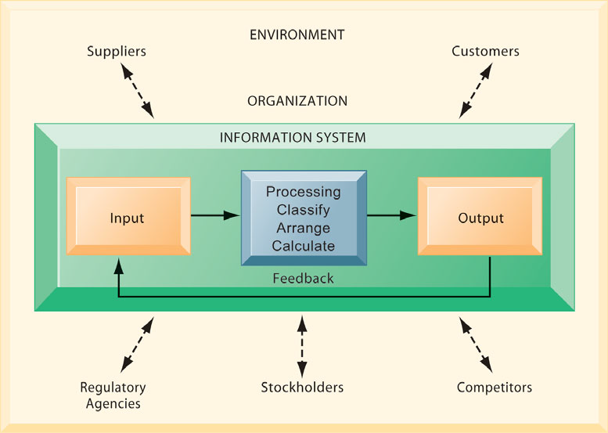
FUNCTIONS OF AN INFORMATION SYSTEM ?
An information system contains information about an organization and its surrounding environment. Three basic activities—input, processing, and output—produce the information organizations need.
Feedback is output returned to appropriate people or activities in the organization to evaluate and refine the input.
Environmental actors, such as customers, suppliers, competitors, stockholders, and regulatory agencies, interact with the organization and its information systems.

Slide 19
Why IS is essential in business ?
Information Systems are essential for conducting day-to-day business as well as achieving strategic business objectives.
Specifically, business firms invest heavily in information systems to achieve six strategic business objectives: operational excellence; new products, services,
and business models; customer and supplier intimacy; improved decision making; competitive advantage; and survival.strategic business objectives.

Slide 20
What makes information systems so essential today? Why are businesses investing so much in information systems and technologies?
In the United States, more than 23 million managers and 113 million workers in the labor force rely on information systems to conduct business. Information systems are essential for conducting day-to-day business in the United States and most other advanced countries, as well as achieving strategic business objectives.
Specifically, business firms invest heavily in information systems to achieve six strategic business objectives: operational excellence; new products, services, and business models; customer and supplier intimacy; improved decision making; competitive advantage; and survival.

Slide 21
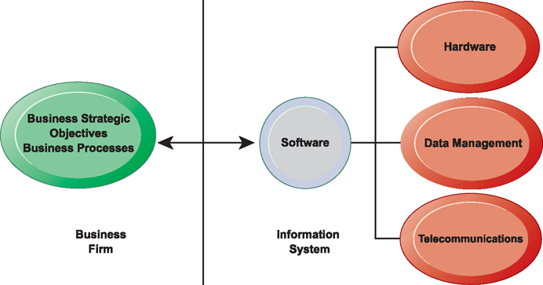
THE INTERDEPENDENCE BETWEEN ORGANIZATIONS AND INFORMATION SYSTEMS
In contemporary systems there is a growing interdependence between a firm’s information systems and its business capabilities.
Changes in strategy, rules, and business processes increasingly require changes in hardware, software, databases, and telecommunications. Often, what the organization would like to do depends on what its systems will permit it to do.

Slide 22
İşlemsel başarı nasıl oluşuyor ?
Businesses continuously seek to improve the efficiency of their operations in order to achieve higher profitability.
Information systems and technologies are some of the most important tools available to managers for achieving higher levels of efficiency and productivity in business operations, especially when coupled with changes in business practices and management behavior.
Information systems and technologies are a major enabling tool for firms to
create new products and services, as well as entirely new business models.
A business model describes how a company produces, delivers, and sells a
product or service to create wealth.
Information systems and technologies are a major enabling tool for firms to
create new products and services, as well as entirely new business models.
A business model describes how a company produces, delivers, and sells a
product or service to create wealth.
Müşteri ve satıcı memnuniyeti, Karar süreçlerinde yararlı gelişme, rekabet edebilmede kolaylık, süregelen teknolojik değişim.

Slide 23
Bilgi sistemini Kısaca tanımlayınız?
An information system can be defined technically as a set of interrelated components that collect (or retrieve), process, store, and distribute information
to support decision making and control in an organization.
In addition to supporting decision making, coordination, and control, information systems may also help managers and workers analyze problems, visualize complex subjects, and create new products.

Slide 24
DIMENSIONS OF INFORMATION SYSTEMS
To fully understand information systems, you must understand the broader organization, management, and information technology dimensions of systems
and their power to provide solutions to challenges and problems in the business environment.
Using information systems effectively requires an understanding of the organization, management,
and information technology shaping the systems. An information system creates value for the firm as
an organizational and management solution to challenges posed by the environment.

Slide 25
Bilgi Yönetimini, yönetimden farkı nedir ?
Information management (IM) is the collection and management of information from one or more sources and the distribution of that information to one or more audiences or all needed worker in the management organization.
Management means the organization of and control over the structure, processing and delivery of information.

Slide 26
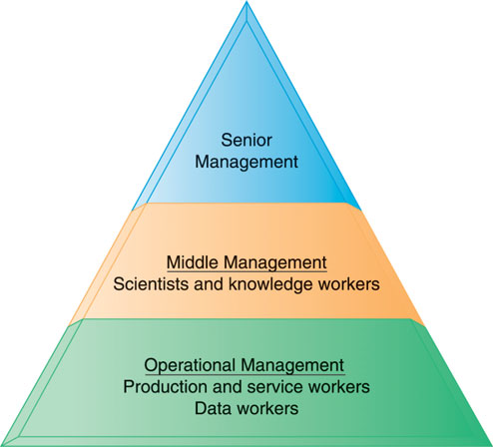
Levels in the firm
Busines organizations are hierarchies consisting of three principle levels: senior-middle and operational managements.
Information systems serve each of these levels. Scientices and knoeladge workrs often work with middlemanagement.

Slide 27
The Business Environment
A firm environment includes specific groups with which the bussiness must deal directly, such as costomers, suppliers, and competitors,
İncluding socioconomic trends, political conditions,technological innovations. And global events.

Slide 28
Main Business functions
The major business functions, or specialized tasks performed by business organizations, consist of:
1- sales and marketing,
2-manufacturing and production,
3-finance and accounting, and
4- human resources
provides more detail on these business functions and the ways in which they are supported by information systems.

Slide 29
The major business functions, or specialized tasks performed by business organizations ?
The major business functions, or specialized tasks performed by business organizations, consist of:
1-Sales and marketing: Selling the organization’s products and services
2-Manufacturing and production: Producing and delivering products and services
3-Finance and accounting : Managing the organization’s financial assets and maintaining the organization’s financial records
4-Human resources Attracting: developing, and maintaining the organization’s labor force; maintaining employee records

Slide 30
Functions of Management ?
Management’s job is to make sense out of the many
situations faced by organizations, make decisions, and
formulate action plans to solve organizational
problems.
Managers perceive business challenges in the environment; they set the organizational strategy for responding to those challenges; and they allocate the human and financial resources to coordinate the work and achieve success.
Throughout, they must exercise responsible leadership.

Slide 31
What are the Information technology tools that managers use to cope with change. ?
Computer hardware is the physical equipment used for input, processing, and output activities in an information system. It consists of the following:
computers of various sizes and shapes (including mobile handheld devices);
various input, output, and storage devices; and telecommunications devices that link computers together.

Slide 32
What are the Information technology tools that information system to use ?
Computer software: That consists of the detailed, preprogrammed instructions that control and coordinate the computer hardware components in an information system.
Data management technology : That consists of the software governing the organization of data on physical storage media.
Networking and telecommunications technology : That consisting of both physical devices and software, links the various pieces of hardware and transfers
Continue →

Slide 33
What are the Information technology tools that information system to use ?
The world’s largest and most widely used network is the Internet. The Internet is a global “network of networks” that uses universal standards to connect millions of different networks.
Internal corporate networks based on Internet technology are called intranets.
Private intranets extended to authorized users outside the organization
are called extranets, and firms use such networks to coordinate thei
activities with other firms for making purchases, collaborating on design, and
other interorganizational work.
For most business firms today, using Internet technology is both a
business necessity and a competitive advantage.
The World Wide Web is a service provided by the Internet that uses
universally accepted standards for storing, retrieving, formatting, and
displaying information in a page format on the Internet.

Slide 34
What are the activities that may be defined The part of the Business Information VALUE CHAIN ?
Every business has an information value chain, which
raw information is systematically acquired and then
transformed through various stages that add value to that
information.
The value of an information system to a business consists
of three group of activities:
Information Processing Activities:
1-Data Collection,Transformation into Business system
2- Business Processes: Supply Chain Management+Enterprise
Management+Customer Managemnt+Knowladge Management.
3-Management Activities: Planning+Coordinating+ Controlling+ Modelink& Decision making

Slide 35
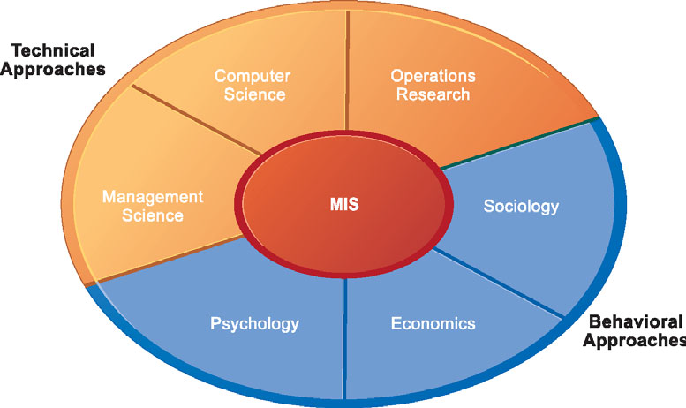
The study of information systems is a multidisciplinary field. No single
theory or perspective dominates.
The study of information systems deals with issues and insights contributed from technical and behavioral disciplines.
In general, the field can be divided into technical and behavioral approaches. Information systems are sociotechnical systems. Though they are composed of machines, devices, and “hard” physical technology, they require substantial social, organizational, and intellectual investments to make them work properly.

Slide 36
Yönetim Bilişim Sistemi oluşumunun iki farklı içeriği nasıl incelenebilir ? Two different approaches in the study of information system ? Technical (teknolojik) and Behavioral (Davranışsal) approach
in the study of information systems. In general, the field can be divided into technical and behavioral approaches.
Information systems are sociotechnical systems. Though they are composed of machines, devices, and “hard” physical technology, they require substantial social, organizational, and intellectual investments to make them work properly.

Slide 37
MIS Lesson-1 Summary-1
A business (also known as company, enterprise or firm) is a legally recognized organization designed to provide goods, services, or both to consumers.
Enterprise: Any organization, including businesses, non-profits and government agencies.
Business processes: are workflows of material, information and knowledge.
Digital firm: is a general term for organizations that have enabled core business relationships with employees, customers, suppliers, and other external partners through digital means and also networks.

Slide 38
MIS Lesson-1 Summary-1
Information technology (IT) is the application of computers and telecommunications equipment to store, retrieve, transmit and manipulate data,^{[1]} often in the context of a business or other enterprise.^{[2]}
Information processing (IP) is the change (processing) of information in any manner detectable by an observer- Such as manager or worker of the Enterprise. Including Data collection and storage, transmission in to Business systems and disemination processes.
Information System(IS) An information system can be defined technically a set of interrelated components that collect or retrive, process, store, and distribute information to support operations,decision making, and control in an organization.

Slide 39
MIS Lesson-1 Summary-2
Information management (IM) is the collection and management of information from one or more sources and the distribution of that information to one or more audiences.
Managemet Information System (MIS) deal with the planing for development, management, and use of information technology tools to help people perform all tasks related to information and organizational business activities and also supports all levels of managerial decisions.

Slide 40
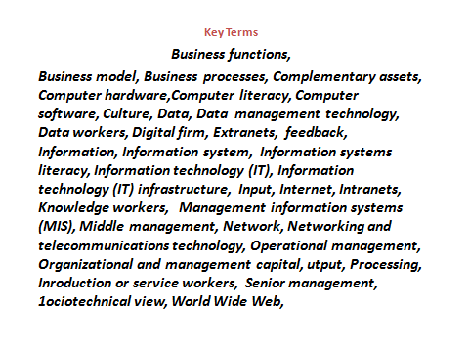
Key Terms of Chapter One

